Slide 1

Knoxville M365 Community Day Simplify Customer Identity & Access Management (CIAM) with Azure AD B2C

Slide 2


B2B Technology Company focused on M365, process-based innovation, enterprise architecture, and fractional CTO services.
Davis G. Trent
Principal Consultant
davis@mach11.co

Slide 3
Sponsor Slide

Slide 4
Session feedback

Slide 5

Agenda
What is AAD B2C?
What is CIAM?
AAD B2C Tenant
Add a local user
Register app
User Flows
Customizing UI
Custom Policies
Progressive Profiles
SSO

Slide 6
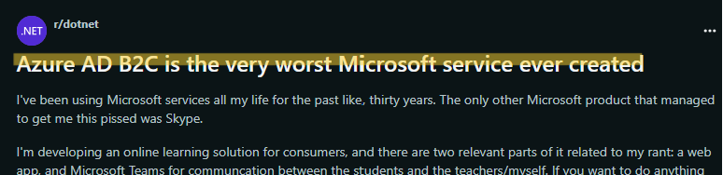
🔥Random reddit hot take…
source: https://www.reddit.com/r/dotnet/comments/wptidc/azure_ad_b2c_is_the_very_worst_microsoft_service/
Notes:
completely separate service designed for a different purpose than Entra
made for devs and IT Pros who need safe and secure auth service
local accounts (stored directly in AAD B2C directory)
social media accounts
enterprise accounts
Entra: only work or school accounts and Microsoft accounts

Slide 7
🎭💀 2B or not 2B…or AAD B2C
AAD – now Entra – at the core, but identity is managed separately in its own tenant
AAD B2C is still the correct name (Entra - What names aren't changing?)
Entra External ID will eventually replace AAD B2C, but is still in preview
(Microsoft Entra ID Dev Center)
White label authentication solution
AWS Cognito
Auth0
Okta
Login.gov

Slide 8
CIAM
Customer Identity and Access Management
Bridges the gap between internal directories and customer UX
SUSI (sign up/sign in)
Profile Editing
Self-service password reset
MFA
Conditional Access
Consistency across application integration, tenant management, operations, and directory management
Multiple IdPs:
Local
Social
OAuth (1.0/2.0)
OIDC
SAML

Slide 9
Let’s Explore the AAD B2C Tenant and create a local user

Slide 10

IaaS (not that IaaS)
Register app
User Flows
Customizing UI
Custom Policies
Progressive Profiles
SSO
Notes:
Identity as a Service
customer-facing websites and apps
users can leverage their preferred accounts: local, social, or enterprise accounts SSO access to custom apps, websites, or APIs.
Like Entra, designed to scale

Slide 11
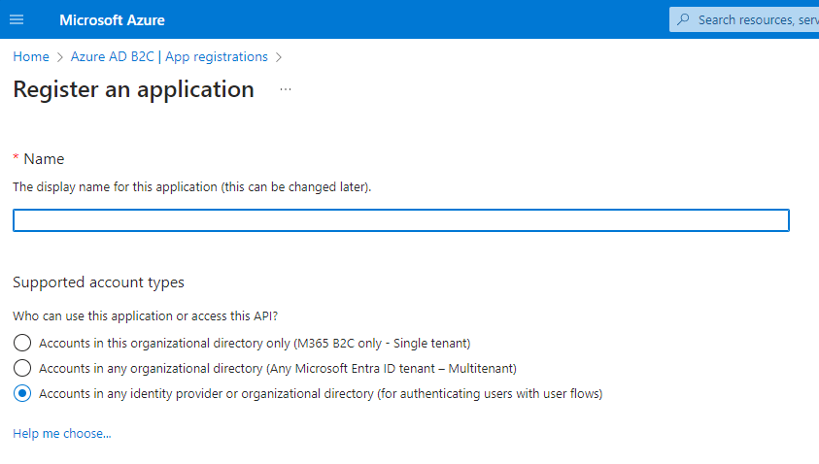
Register an application (similar to registering an app in Entra)
Notes:
TFP: Trust Framework Policy

Slide 12
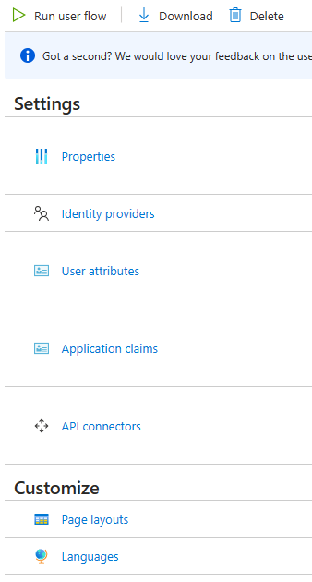
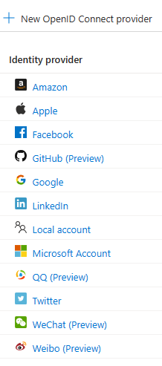
User Flows
Out-of-the-Box Policy (constrained customization)
IdPs
Attributes/claims
API connectors

Slide 13
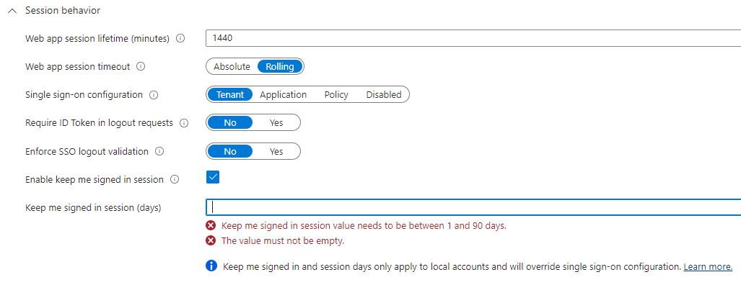
SSO
Check box, TTL, etc.
Must do extra work to sign out of external sites/apps
Notes:
AAD B2C removes the cookie, but other apps may implement other SSO mechanisms

Slide 14
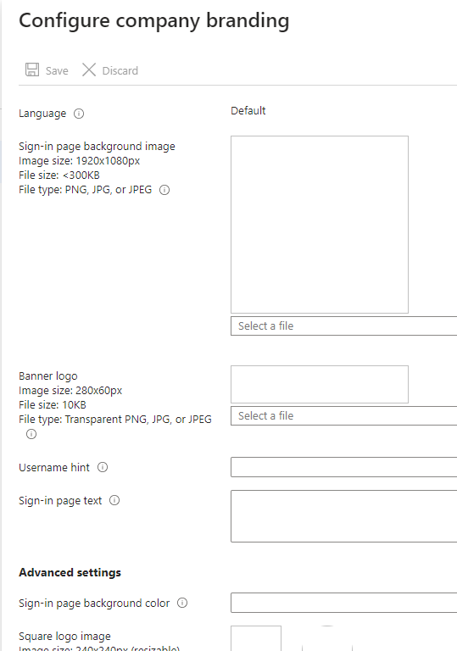
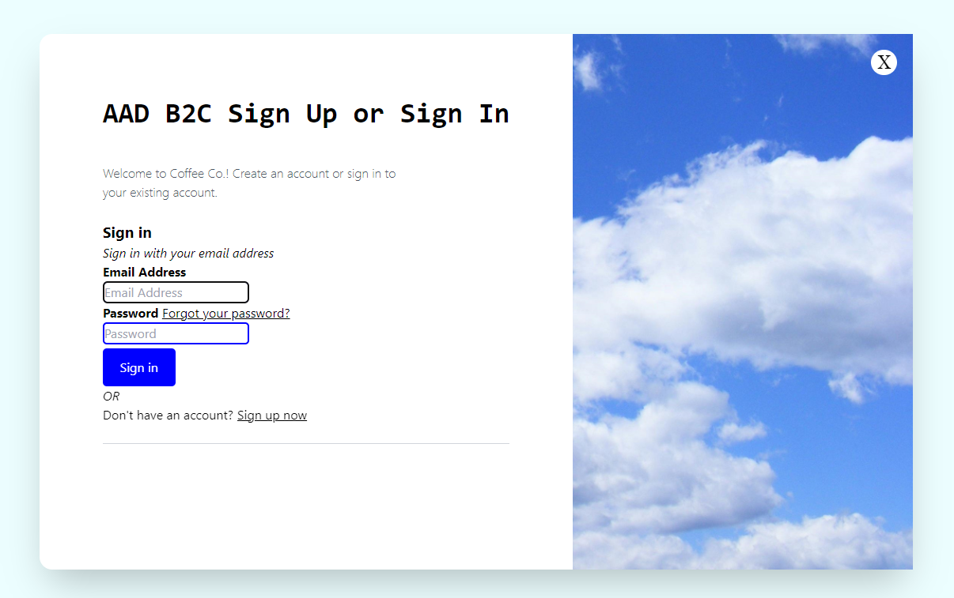
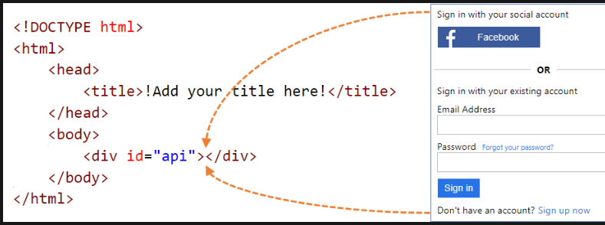
Customizing the UI
Customize the user interface with HTML templates in AAD B2C
Customize the user interface - Azure AD B2C | Microsoft Learn
Notes:
https://m365custompages.blob.core.windows.net/custom-pages/unified.html
https://woodgrovedemo.com/

Slide 15
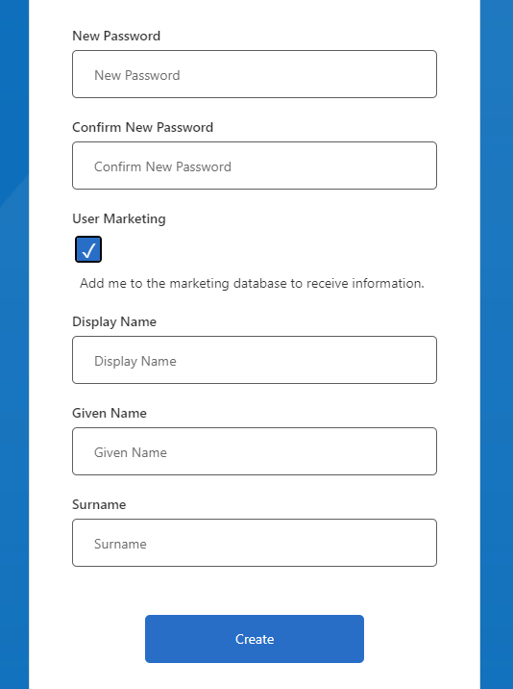
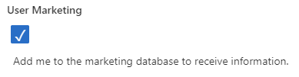
Custom Policies
Call external APIs, integrate with services, etc.
Progressive Profiling
Automated setup app: IEF Setup (b2ciefsetupapp.azurewebsites.net)

Slide 16
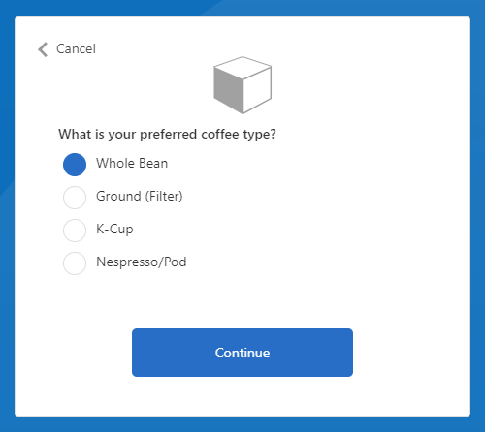

Custom Policies (cont.)
Progressive Profiling
Automated setup app: IEF Setup (b2ciefsetupapp.azurewebsites.net)
Notes:
AAD B2C removes the cookie, but other apps may implement other SSO mechanisms

Slide 17

Thank you for attending! Please reach out with any questions!
Davis G. Trent
Principal Consultant
davis@mach11.co

Slide 18
Session feedback

